Slide 1
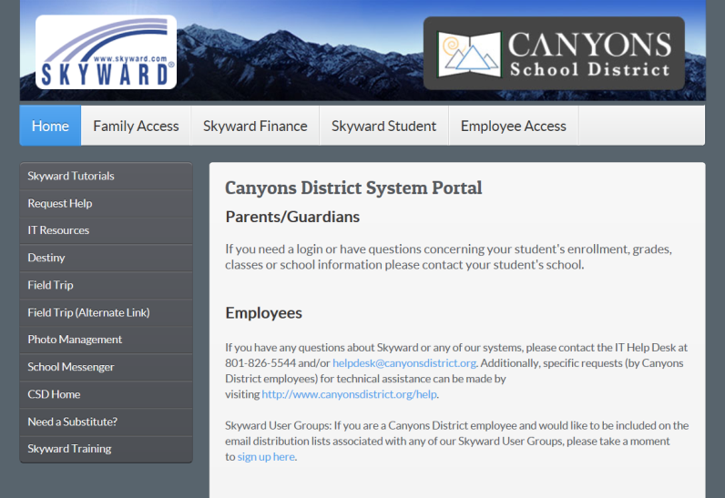
Step 1: Using a web browser, navigate to the “Skyward Family and Student Access” website at: http://skyward.canyonsdistrict.org/ then click on the “Family Access” button

Slide 2
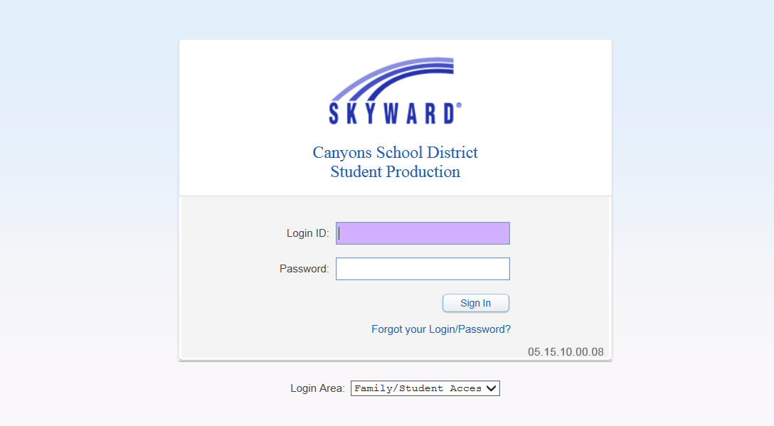
Step 2: Enter your unique User ID and Password. If you need your unique User ID and/or password please contact the Attendance Office

Slide 3
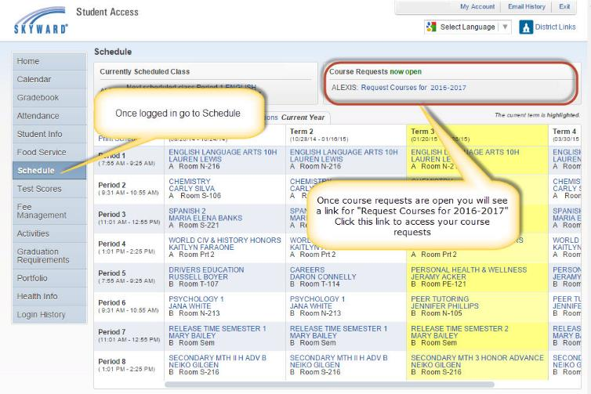
Step 3: Click on the “Schedule” button in the left menu area. At the top of the schedule screen you will see a section that says “Course Requests now open” and from there you can select “Request Courses for 2023 - 3034”.
1st
Request Courses for 2023-2024
Once logged in go to “Schedule”
2nd
Once course requests are open you will see
a link for “Request Courses for 2018-2019”
Click this link to access your course requests.
Some classes may already appear on your course requests. These are pre-assigned classes that you are required to take.

Slide 4
Step 4: To request courses for the 2023 - 2024 school year, choose the “Request Courses” tab
Available Courses for 2023-2024
3rd
2nd
1st

Slide 5
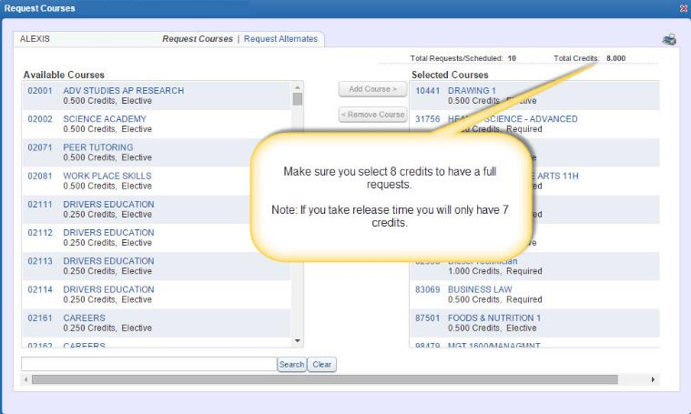
Step 5: Continue the process of selecting the courses until all courses you wish to request for the 2023 - 2024 school year appear in the “Selected Courses” box on the right.
Make sure you select 8 credits to
have a full request.
Note: If you take release time you will only have 7 credits.
8 credits!

Slide 6
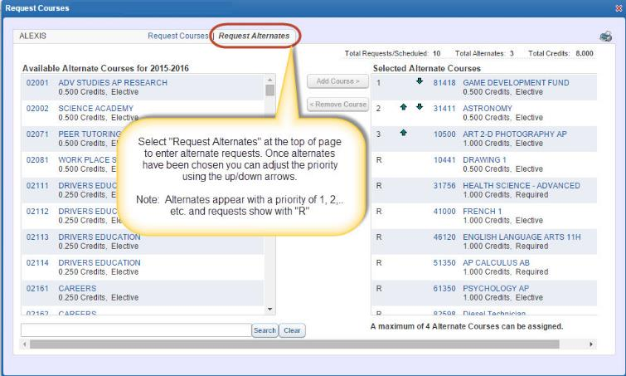
Step 6: To request course alternates for the 2023 - 2024 school year, choose the “Request Alternates” tab. Then REPEAT the same process as the “Requests Courses” (Step 4).
Available Alternate Courses for 2023 - 2024
Remember that alternates must be requested in order to have options when adjusting schedule at a later date

Slide 7
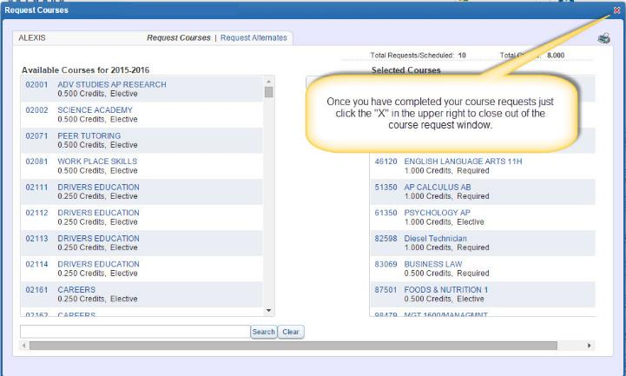
Step 7: Now that you are finished click the “X” button in the upper right of the page to close your session. You can return to the Skyward Family/Student Access website to review and/or make course selection modifications at any time during the open window.
Available Courses for 2023 - 2024

