Slide 1
Union’s Progressive Discipline

Slide 2
Union’s Basic Behavioral Expectations
Caring and Respectful Attitude
Arrive on Time
Take Responsibility
Safety First
+
=
CATS Code

Slide 3
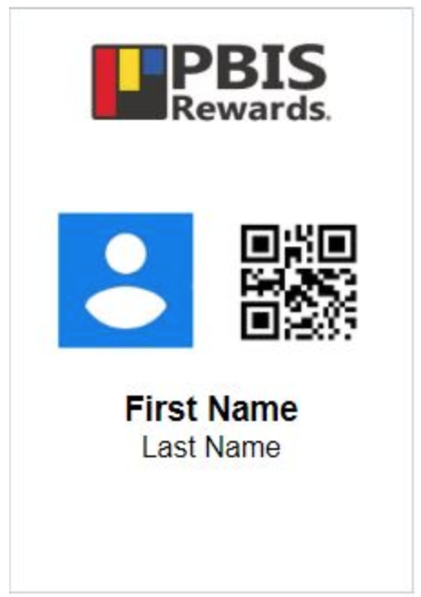
If You FOLLOW Rules
PBIS Card Points: Are awarded to you for following expectations. You can use the PBIS points to “purchase items” at the school store and be entered in drawings for treats and prizes.

Slide 4
If You FOLLOW Rules
Bobcat of the Month: Award Breakfast and Award
Honor Roll parties- given at the beginning of each term for students on the last quarters honor roll.

Slide 5
RESPONSIBILITY:
KNOW
YOU
ARE
RESPONSIBLE FOR
YOUR
BEHAVIOR

Slide 6
How Can You Get in Trouble?
Inappropriate Language
Swearing, Name Calling, Teasing, Verbal Argument
Physical Contact
Getting in Other’s Space, Play Fighting, Mutual Physical Play, Pinching, PDA

Slide 7
How Can You Get in Trouble?
Defiance
Talking Back, Refusing to Follow Directions, Lying, Continuing Disruptive Behavior after being asked to stop
Disruption
Making noises at inappropriate times, Constant Talking, Throwing Small Objects, Using inappropriate Volume

Slide 8
How Can You Get in Trouble?
Property Misuse
Writing on tables, desk, or other school property
Plagiarism
Cheating on Test, Copying Others Work, etc.
Dress Code Violations

Slide 9
If You Don’t Follow the Rules: Step 1
1st Teacher Reminder:
For most first-time Infractions you will receive a Verbal Warning from your teacher.

Slide 10
If You Don’t Follow the Rules: Step 2
2nd Reminder:
The 2nd time a teacher needs to remind you about following classroom expectations you will have an extended conversation with your teacher and stay 30 seconds after class.

Slide 11
If You Don’t Follow the Rules: Step 3
3rd Reminder
The third time your teacher needs to remind you of a behavioral expectation will result in a reflective conversation with your teacher and 1 minute after class.
If there is an issue with face covering non-compliance, then it will be addressed in the hallway with Ginger or administration.

Slide 12
If You Don’t Follow the Rules: Step 4
4th Reminder
Removal to “Think Time” for reflection

Slide 13
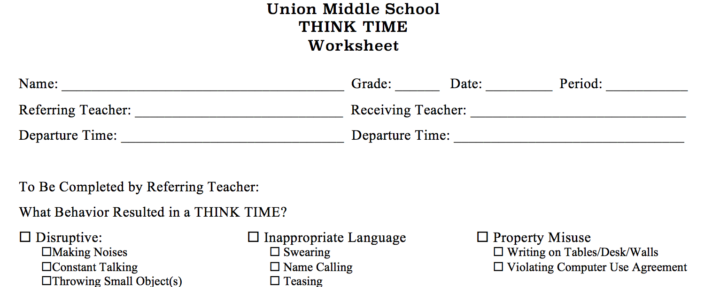
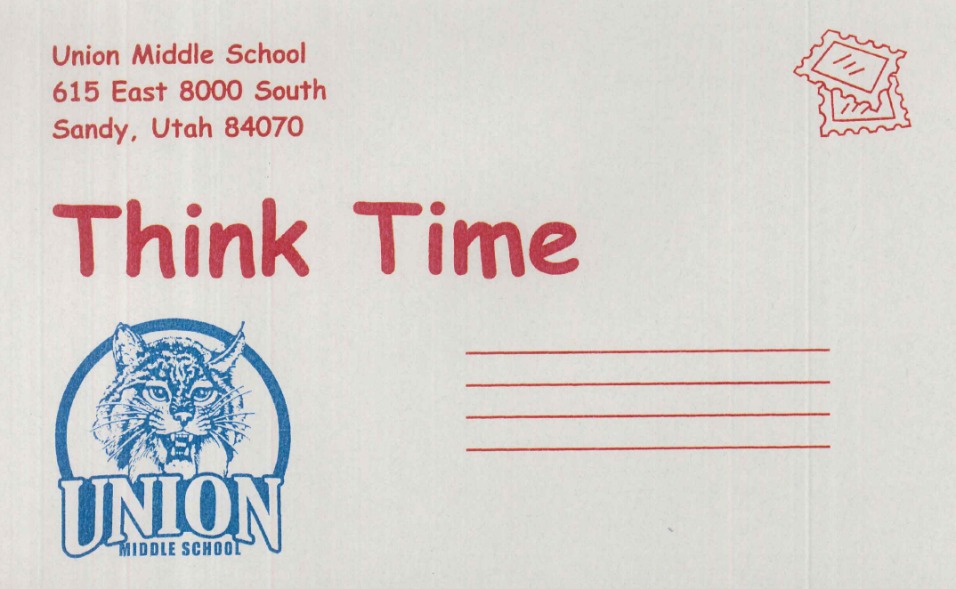
How does Think Time Work?
Your teacher will give you a Think Time form filled out with the problem behavior, another teachers name, room number and a postcard to be sent home.

Slide 14
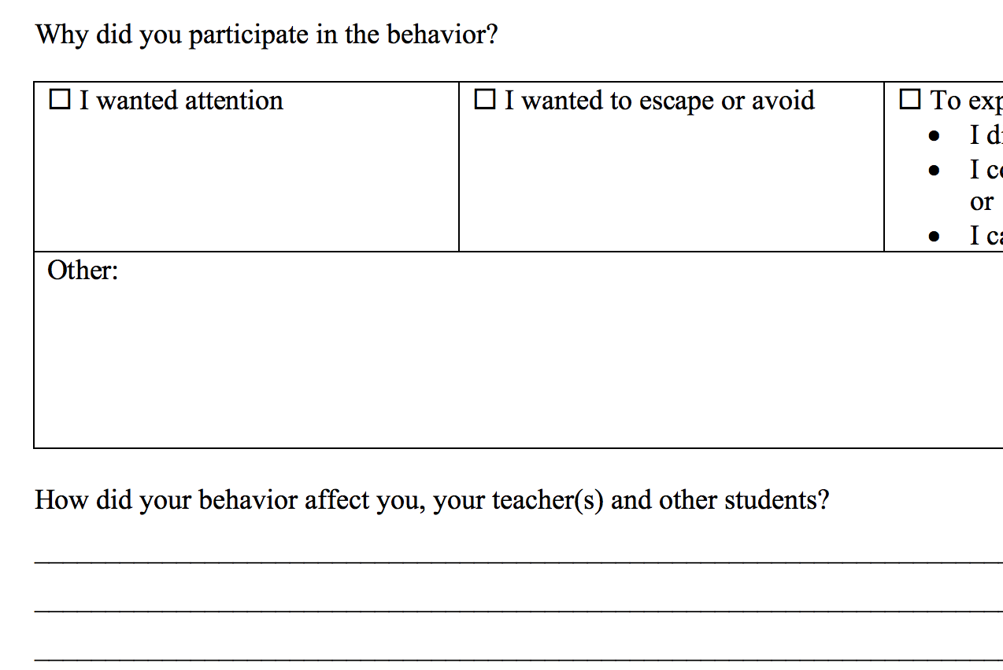
How Does Think Time Work?
Report directly (do not roam) to the Receiving Think Time Teacher.
Wait until the Think Time teacher is free then follow her/his instructions on where to sit.
Complete your Think Time Worksheet and Postcard. Think about your answers and fill it out completely and accurately.

Slide 15
How Does Think Time Work?
Wait quietly for the Think Time Teacher to discuss your answers with you.
When told, report back to your classroom teacher.

Slide 16
If You Don’t Follow the Rules: Step 5
5th Reminder
Conference or Phone Call with Parent/Guardian

Slide 17
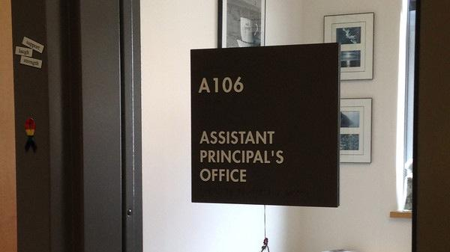
If You Don’t Follow the Rules: Step 6
Office Referral

Slide 18
Let’s walk through an example with…
&
Henry
Mrs. Barnes

Slide 19
Henry was asked to start on his assignment by his teacher, Ms. Barnes. He did not and put his head on the desk.
Ms. Barnes, asked Henry if everything was alright. Henry nodded. Ms. Barnes asked Henry to sit up and get started on his assignment.
Instead of starting his work, Henry started talking to his neighbor.
Ms. Barnes said, “Henry since you didn’t start on your assignment and you are now talking to someone else you will need to stay after class for 30 seconds.”

Slide 20
Henry did not care and continued talking to his neighbor.
Ms. Barnes asked if Henry needed any help on his assignment.
Henry ignored her and continued talking to his neighbor.
Ms. Barnes said, “Henry I am trying to offer help. You continue to talk and you not are attempting your work. You will need to stay 60 seconds after class.”

Slide 21
Henry sticks his tongue out at Ms. Barnes and continues talking to other students in the class.
Ms. Barnes sends Henry to
When he returns he hands Ms. Barnes his Think Time form, which is ripped in half. He sits at his desk, breaks his pencil, folds his arms and defiantley looks at Ms.Barnes.
Ms. Barnes kneels next to Henry and says, “Henry I really want to help you. I will be calling your mom tonight to see if we can find a way to work together and support you.”

Slide 22
Henry shouts, “You are a big old snitch.” as Ms. Barnes is walking away.
Ms. Barnes sends Henry to his assistant principal’s office

Slide 23
As you can see…
You have a lot of chances to correct your behavior before your parents are contacted and ending up in the Assistant Principal’s office.
Remember, your behavior is a result of the choices you make and you are responsible for your actions.

Slide 24
Follow the CATS Code and…
We will have a GREAT year!!

Slide 25
∞
Infinite Reasons | Middle School is Great

Slide 26
Today’s most awkward moment will be tomorrow’s funniest memory.

