Slide 2
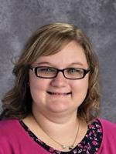
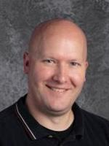
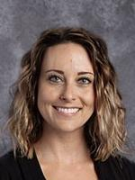
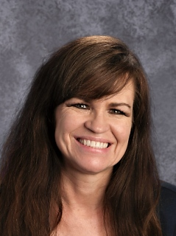
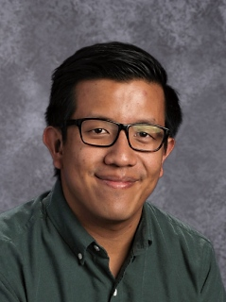
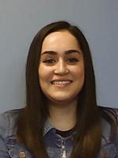
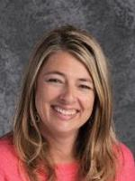
Teachers
Improving Grades
Lost Textbook
Math Tutoring: (your Math Teacher)
Missing Assignments
Witnessed Someone with Drugs, Alcohol, or a Weapon: IMMEDIATELY SEE ANY STAFF MEMBER

Slide 3
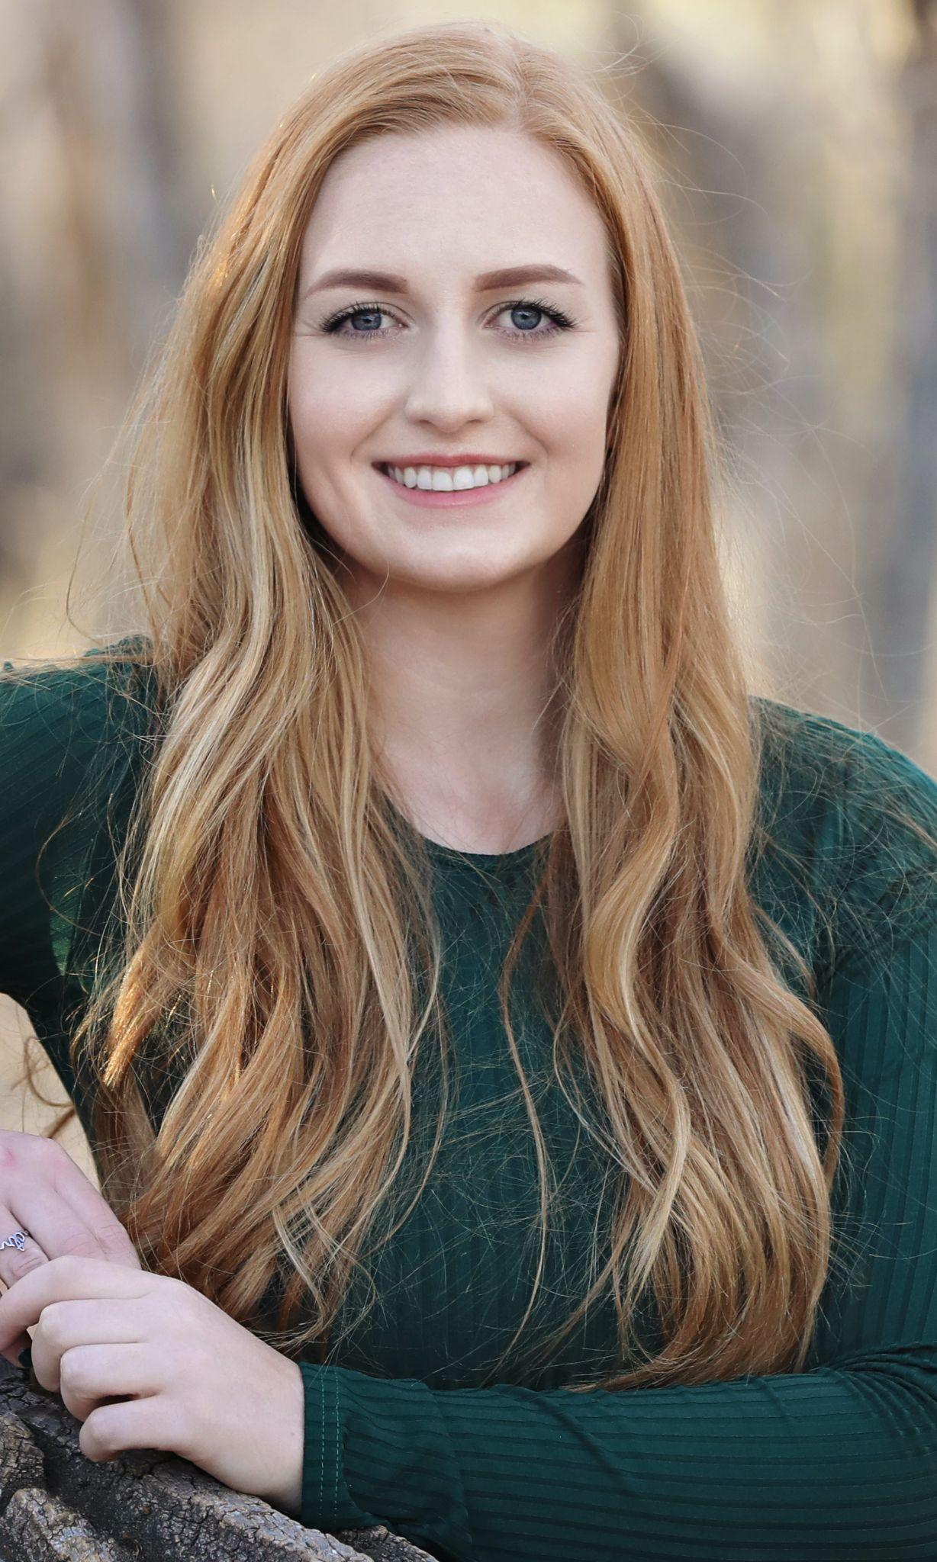
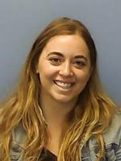
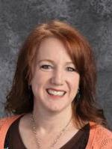
Counselors
Ms. Robinson
(A-F)
Drug or Alcohol Problems
Feeling Blue
Feeling Harassed Physically, Verbally or Sexually
Improving Grades
Peer Mediation
Planning for High School
Schedule and Elective Questions
Problems with Teachers
Witnessed Someone with Drugs, Alcohol, or a Weapon: IMMEDIATELY SEE ANY COUNSELOR
Ms. Wertner (G-N)
Ms. Nelson (O-Z)

Slide 4
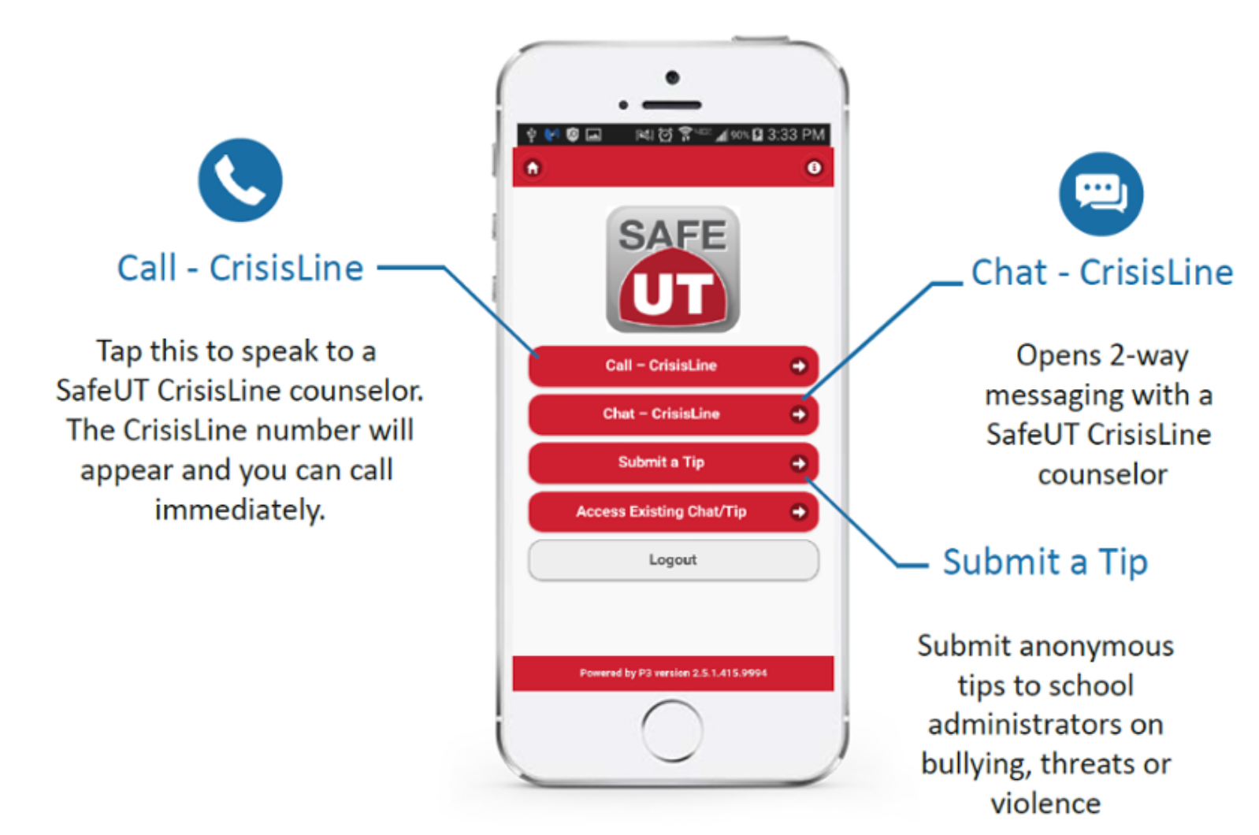
Utah SAFE UT APP
If you don’t feel comfortable talking to a counselor or you need help after school hours, use the SAFE UT APP.
With this APP you can:
Talk with a Crisis Counselor
You can text a Crisis Counselor
You can submit an anonymous tip about bullying or unsafe situations
Link is also located on Union’s web page

Slide 5
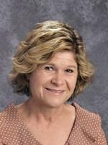
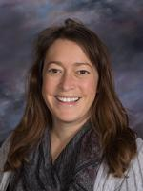
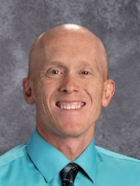
Administration
Ms. McCann
School
Principal
Drug or Alcohol Problems
Feeling Blue
Feeling Harassed Physically, Verbally or Sexually
Intramurals
Peer Mediation
Problems with Teachers
Theft of Personal Property
Witnessed Someone with Drugs, Alcohol, or a Weapon: IMMEDIATELY SEE ANY ADMINISTRATOR
Ms. McKinney
A through K
Mr. Hellwig
L through Z

Slide 6
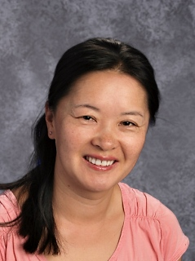
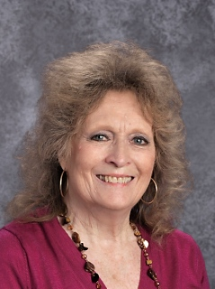
Library Media Center
Lost Library Book
Skyward
Recommendations for good reads
Ebooks with Sora
Help with Noodle Tools/ citing sources
Research related questions
Ms. Zhang
Ms. Bosch

Slide 7
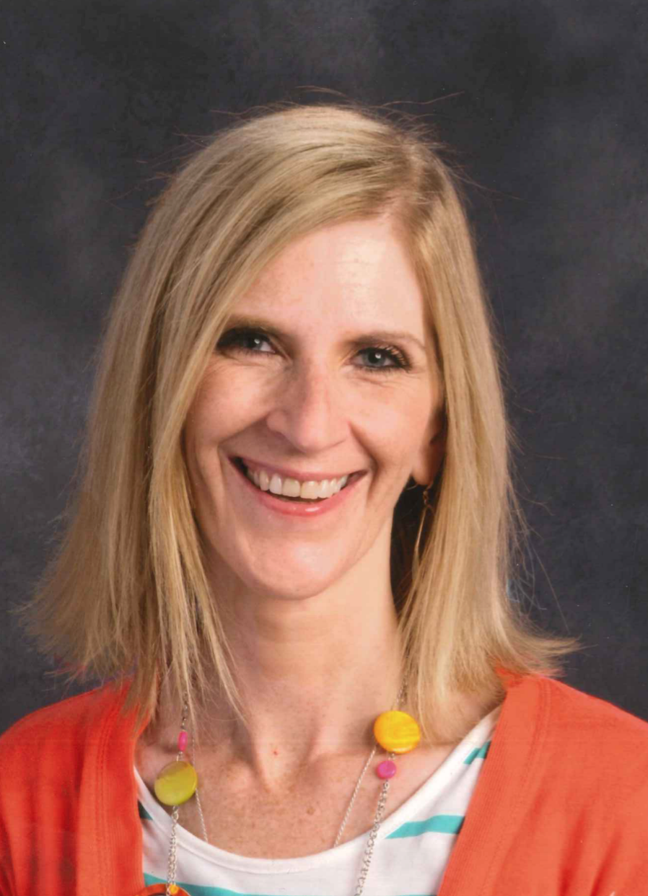
Main Office
Fines
Locker Stuck or Broken
Skyward Login
Witnessed Someone with Drugs, Alcohol, or a Weapon: IMMEDIATELY SEE ANY STAFF MEMBER
Ms. Elmer
Ms. Brey

Slide 8
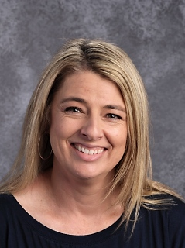
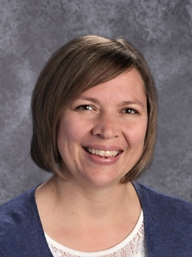
Attendance Office
Sick, ill or injured
Transportation
Late Arrival
Early Dismissal
Confiscated Cell Phones
Ms. West
Ms. Densley

Slide 9
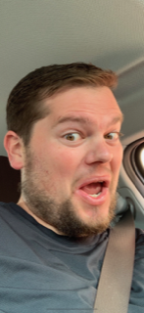
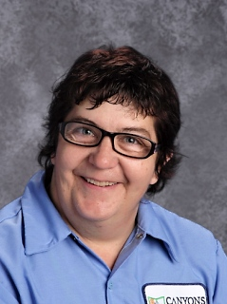
Custodians
Locker Stuck or Broken
Spill in the Hallway or Cafeteria
Mr. Van Gilder
Ms. Kelson

Slide 10
∞
Infinite Reasons | Middle School is Great

Slide 11
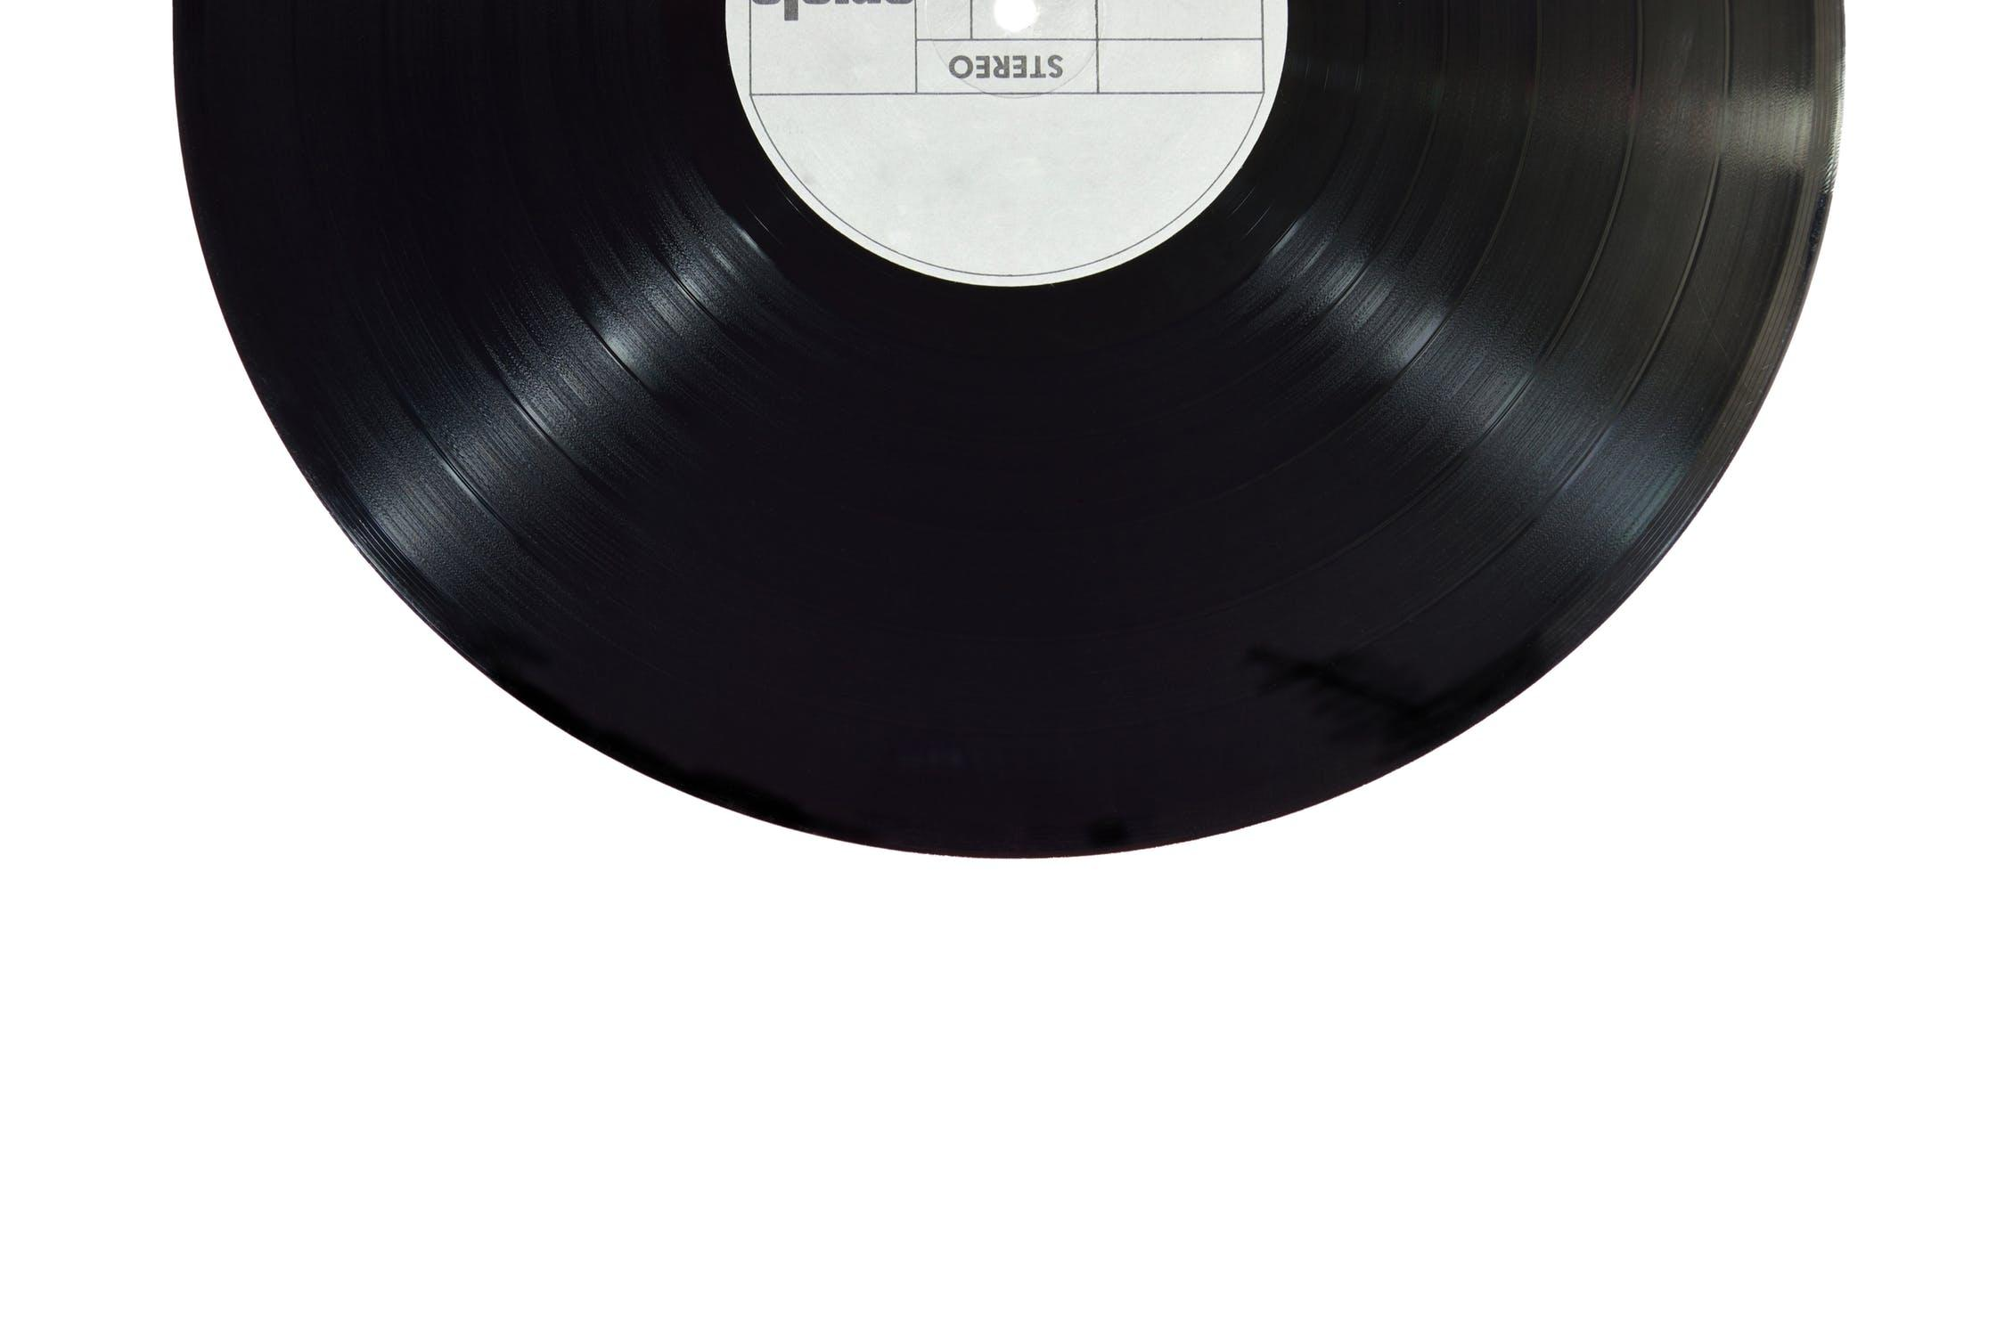
Music in the Hallways During Passing Time

