Slide 2
Steps to a Successful Lunch:

Slide 3
First, determine which lunch you have
Check your schedule:
4C = 1st lunch (before 4th period)
4D = 2nd lunch (after 4th period)

Slide 4
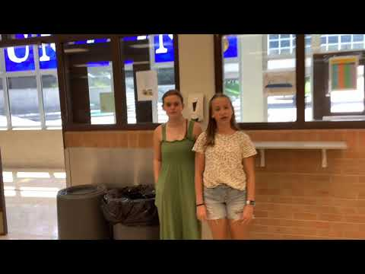

Slide 5
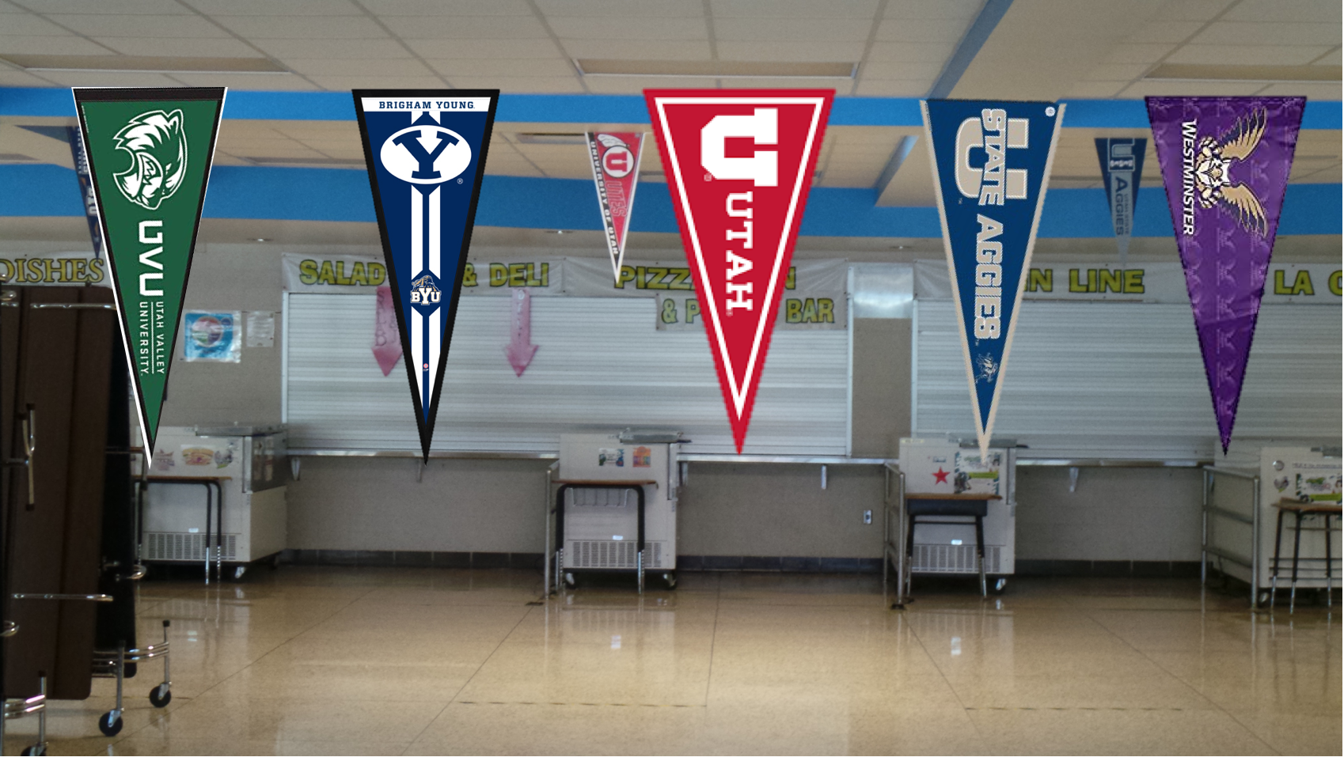
What lunch options do I have?
Choose a line based upon the college pennants & food options:
BYU: PB&J Deli Sandwich
U of U: Pizza & Salad
Utah State: Main Line
Westminster: A La Carte

Slide 6
∞
Infinite Reasons | Middle School is Great

Slide 7
COOKIE TUESDAY

