Slide 1
Welcome Back Union Bobcats!

Slide 2
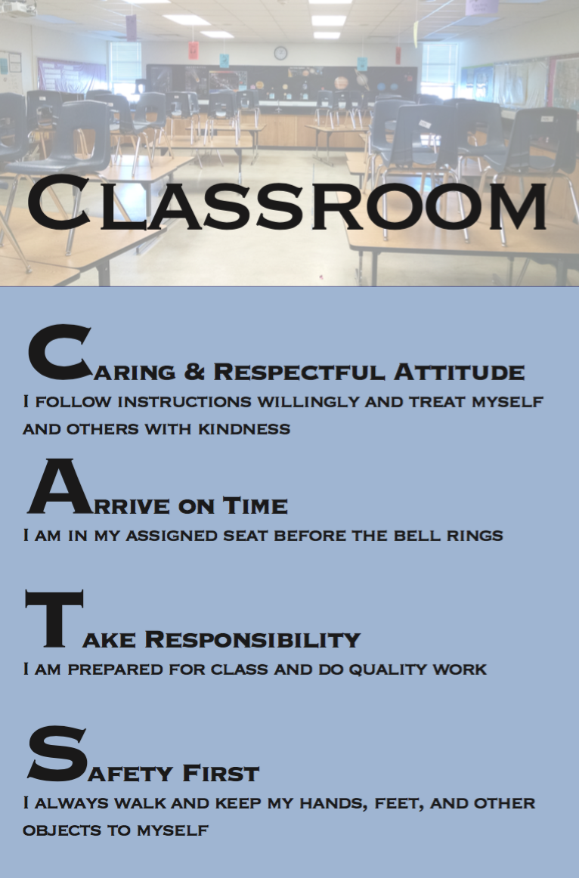
School Expectations
Caring and Respectful Attitude
Arrive on Time
Take Responsibility
Safety First

Slide 3
Speaking of the CATs Code
Caring and Respectful, Responsible, and Safe...
Current 22-23 COVID-19 Policies:
CSD will continue deep cleaning processes at schools
CSD will continue to ask students to wash hands, sanitize whenever possible
CSD will not mandate masks this year (so far), per the state legislature
This means…
you may choose to wear a mask
you may choose not to wear a mask
This is a personal decision. No student should feel pressured to make a choice, one way or another.
Please be respectful of your peers and adults as they determine what is best for them.

Slide 4
Now, let’s be sure you know where to go:
Reading Your Schedule

Slide 5
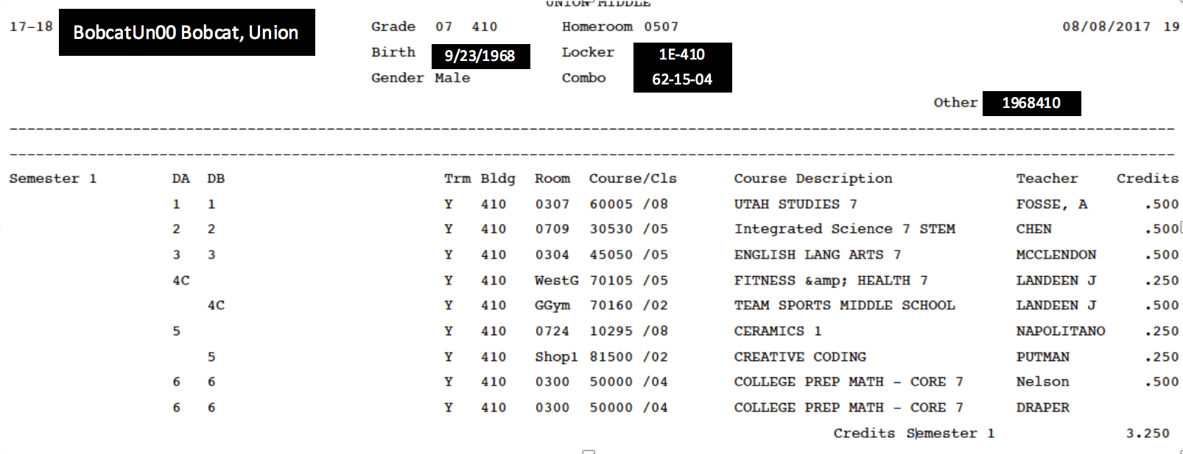
Reading Your Schedule
A-Day Schedule
B-Day Schedule

Slide 6
What lunch do I have?
The letter after
4th period
tells you which lunch you have.

Slide 7
What does 7th period Advisory on my schedule mean?
This year, each student has been assigned an advisory teacher.
This class is held ONLY on FRIDAY after 2nd period (for 30 minutes)
In this class we will be building connections and learning about social emotional skills.
7th Advisory only meets on Friday.

Slide 8
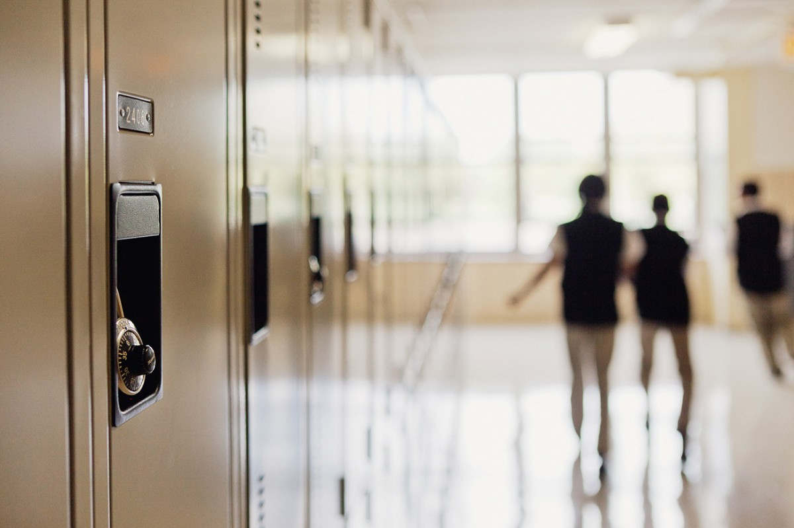
Locker Number
The number before the dash (-) let’s you know the hallway where your locker is located.
Locker Combo

Slide 9
E- Hall Pass Orientation/ Practice
Please have your students use the Union Home Page to log in
They use their same user name and password.
Have them practice requesting a pass
Basic Pass Principles:
two per class at a time
two AUTO passes restroom passes per day- unless abused
PROXY passes are requested passes- to wellness room, nurse, etc.
Video: https://vimeo.com/689243343/8384147d1b

Slide 10
∞
Infinite Reasons | Middle School is Great

Slide 11
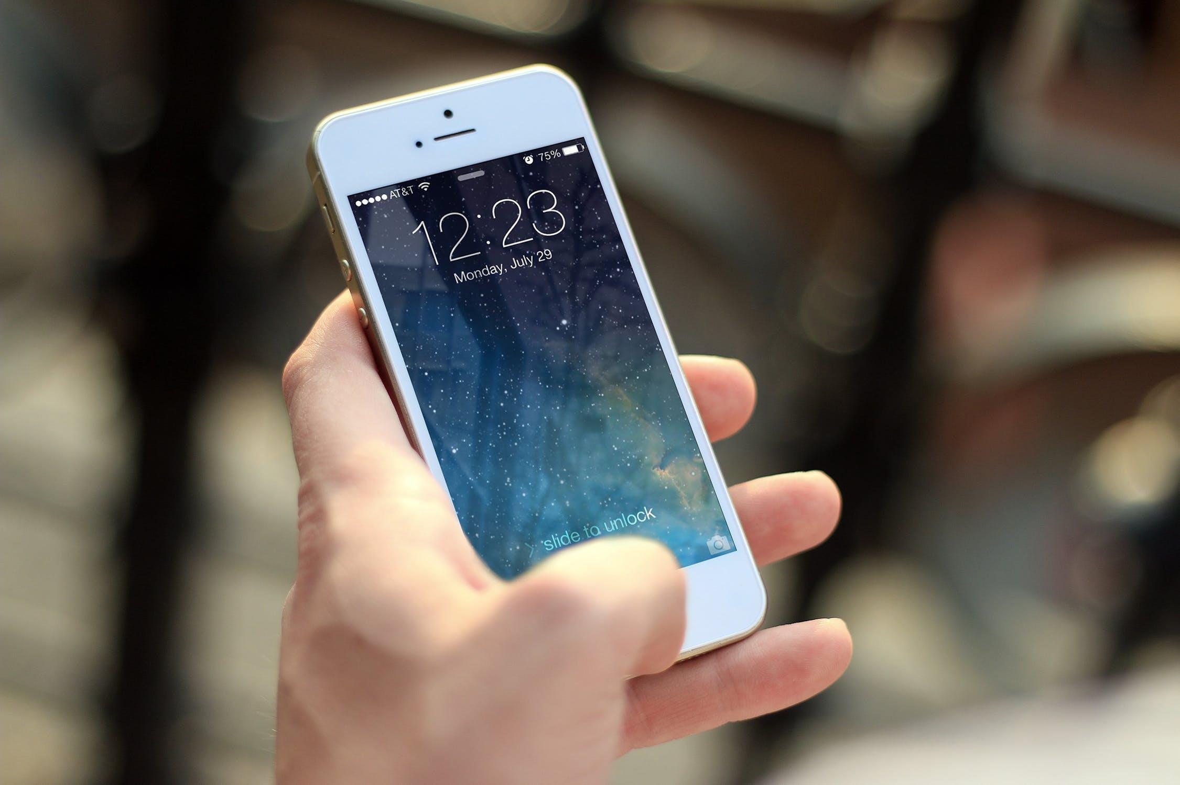
You Can Use Your Cell Phone
(lunch and passing periods) (if done appropriately)

