Slide 2
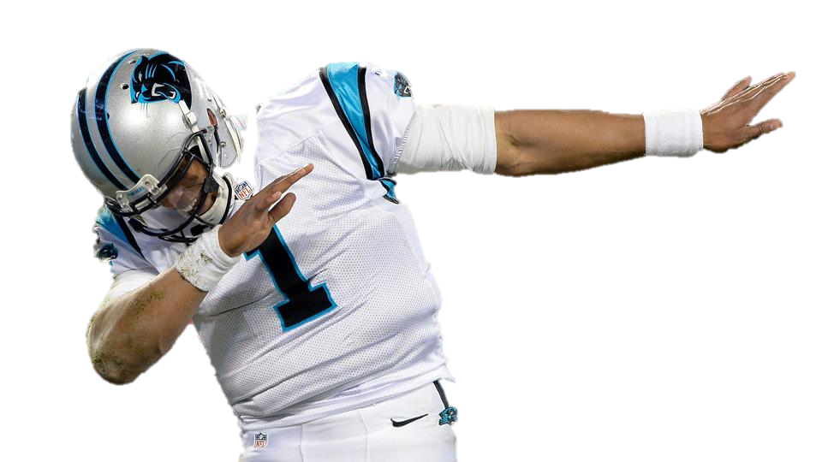
Caring & Respectful Attitude
Enter quietly, use an inside voice, and applaud appropriately
Be Respectful and
Avoid Dabbing

Slide 3
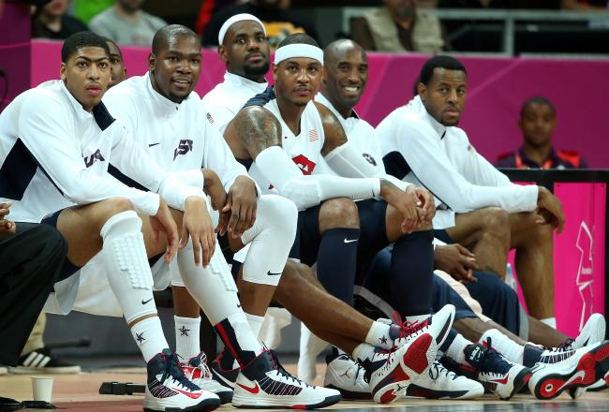
Arrive on Time
Quietly sit with your class

Slide 4
Take Responsibility
Turn off your electronics
Be a polite audience member

Slide 5
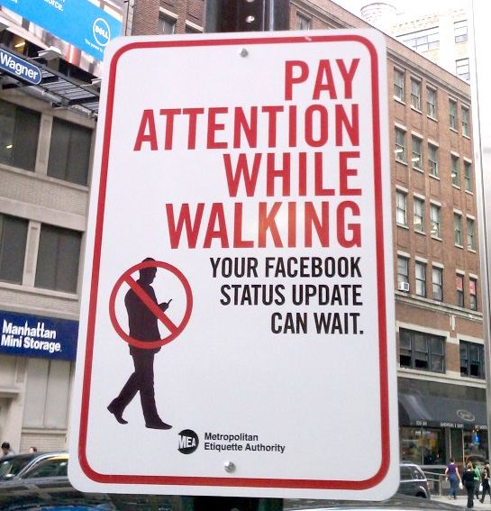
Safety First
Always walk
Follow directions
Keep hands, feet, and other objects to yourself

Slide 6
∞
Infinite Reasons | Middle School is Great

Slide 7
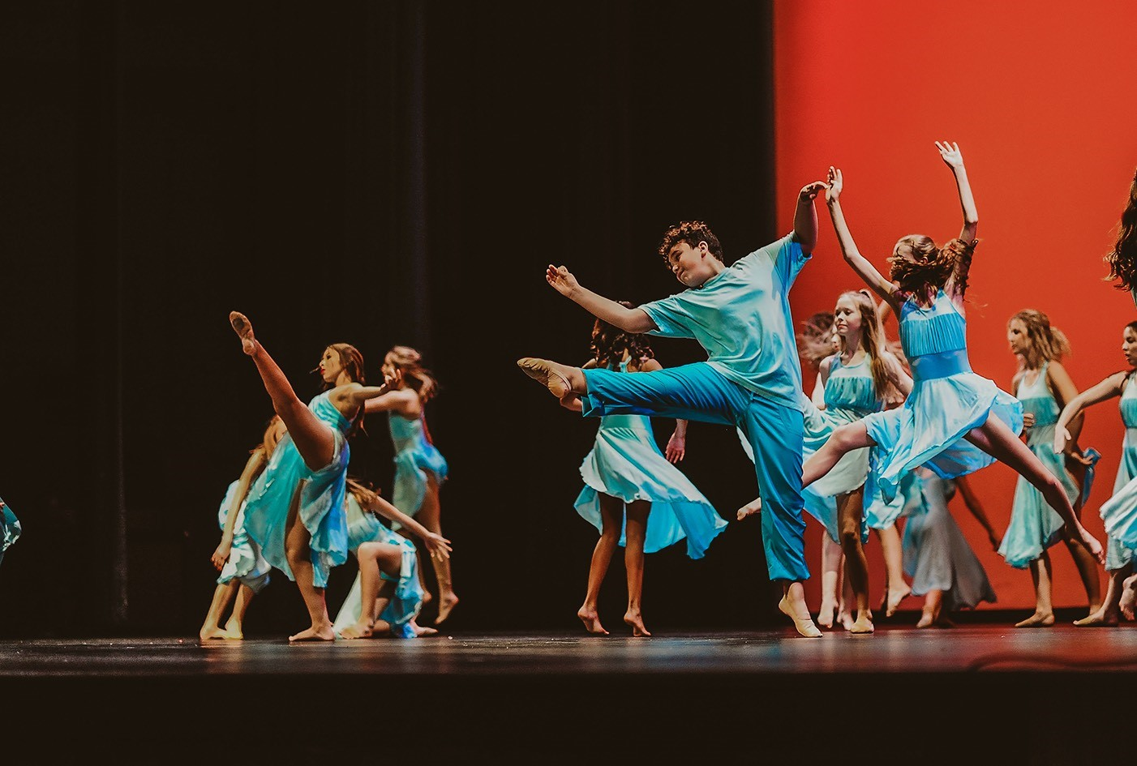
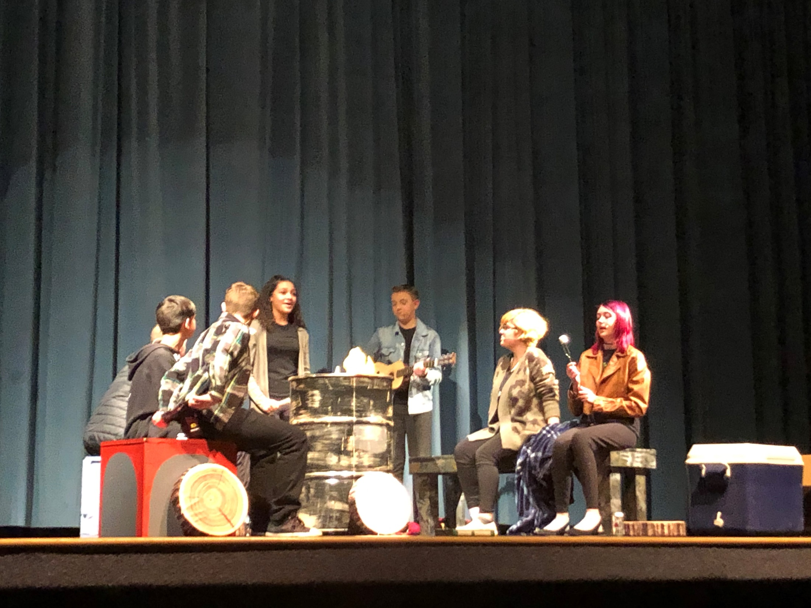
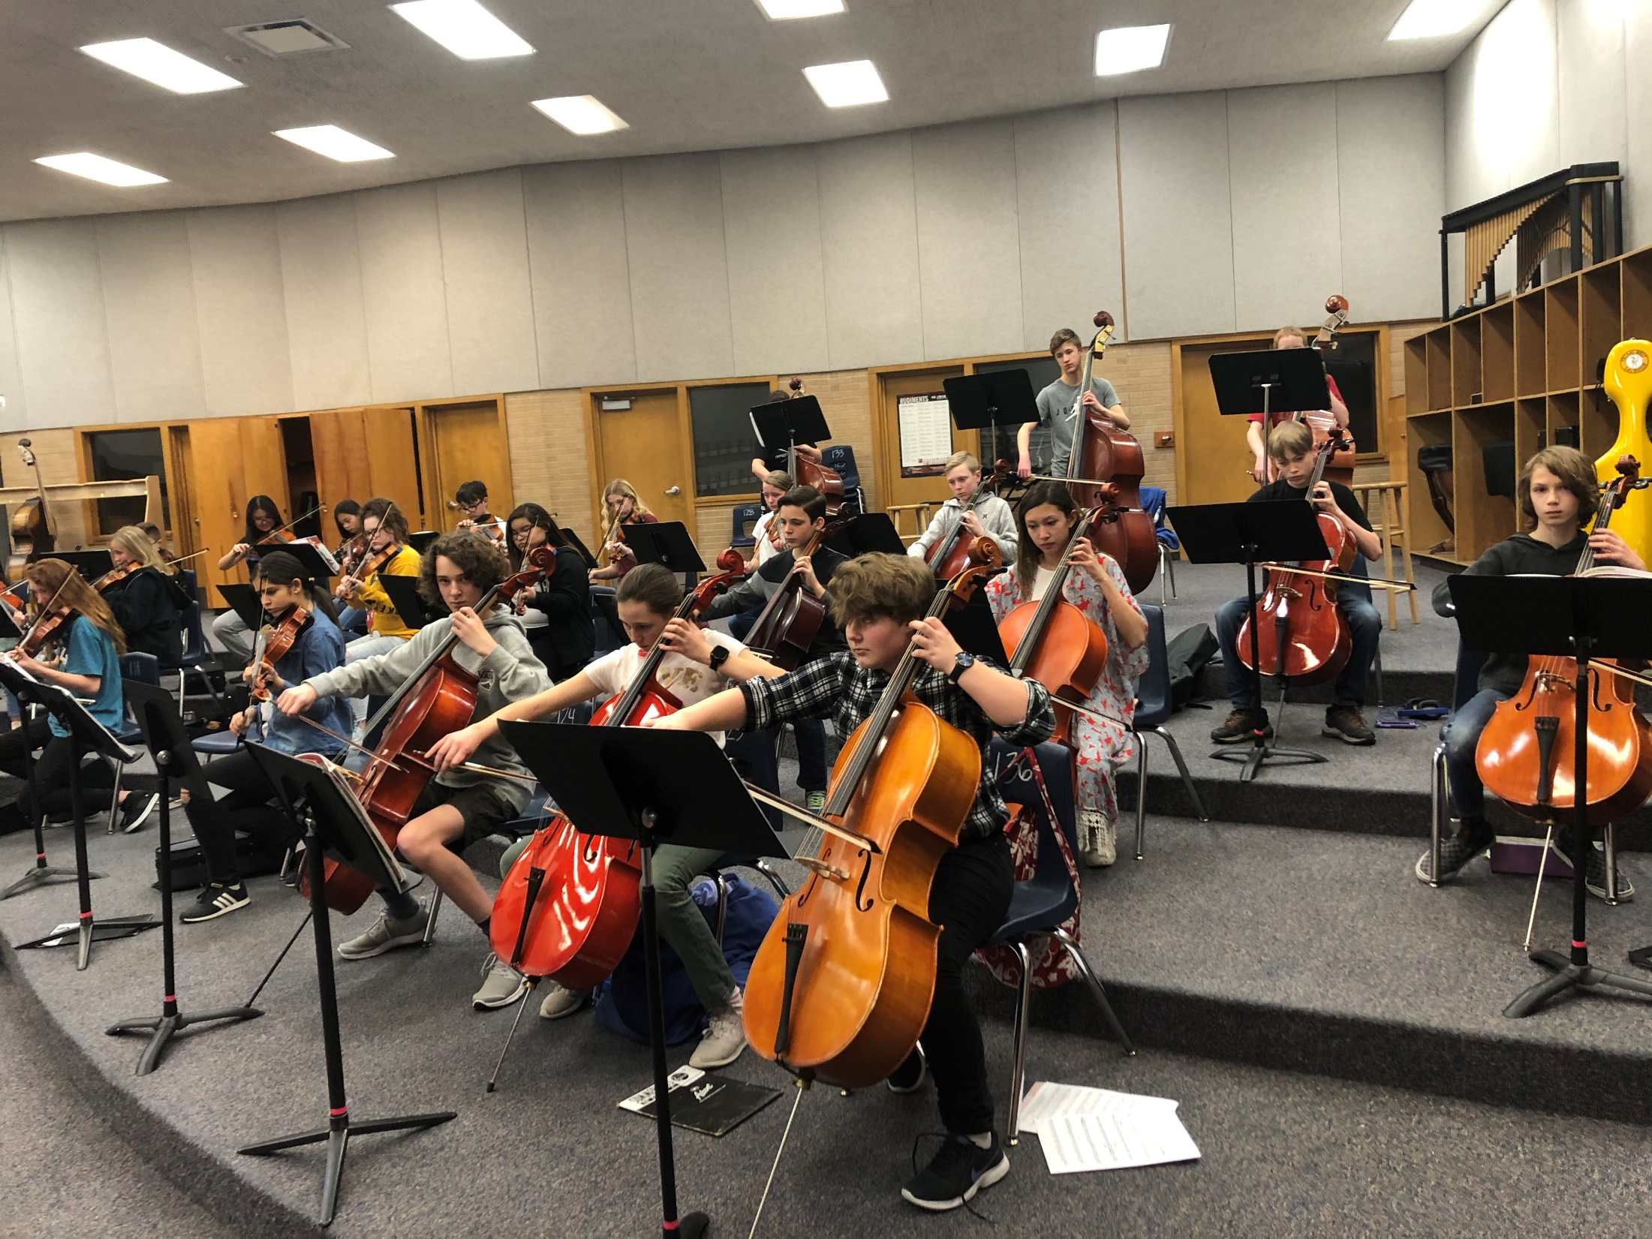
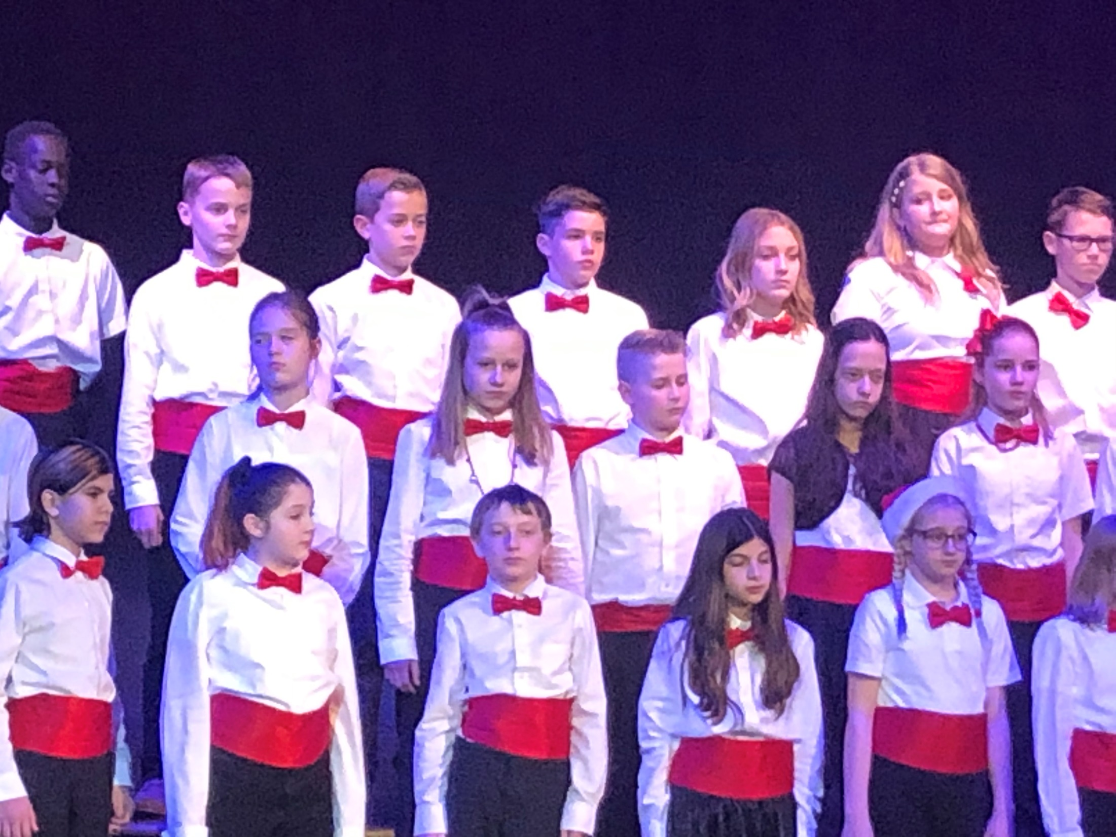
Performing Arts!

