Slide 1
gangs and prohibited substances

Slide 2
Gang Policy
Students who engage in gang related fighting, threats, intimidation, harassment, graffiti or assault:
Will be SUSPENDED until a parent/guardian conference is held
Police will be involved with gang related activity
Gang related colors, language, paraphernalia, recruiting, jumping in, or other illegal activities is NEVER ACCEPTABLE.

Slide 3
Drug and Alcohol Policy
Use, possession, or distribution of drugs or alcohol will result in immediate SUSPENSION.
Continuing 2020-21
If you are caught using, in possession of, or distributing drugs or alcohol you will be:
Charged with a Class A Misdemeanor by Sandy City Police
Fined 50 dollars
Required to take a 4-week substance abuse evening class

Slide 4
Medication
Students are allowed to carry prescription or "over-the-counter" medication at school—NOT TO EXCEED AN 8-HOUR DOSAGE.
Any other medication must be kept and administered through the Attendance Office.
It is illegal to take prescription drugs that have not been prescribed to you.
NEVER SHARE or accept medication!
Sharing medication will result in a SUSPENSION.

Slide 5
∞
Infinite Reasons | Middle School is Great

Slide 6
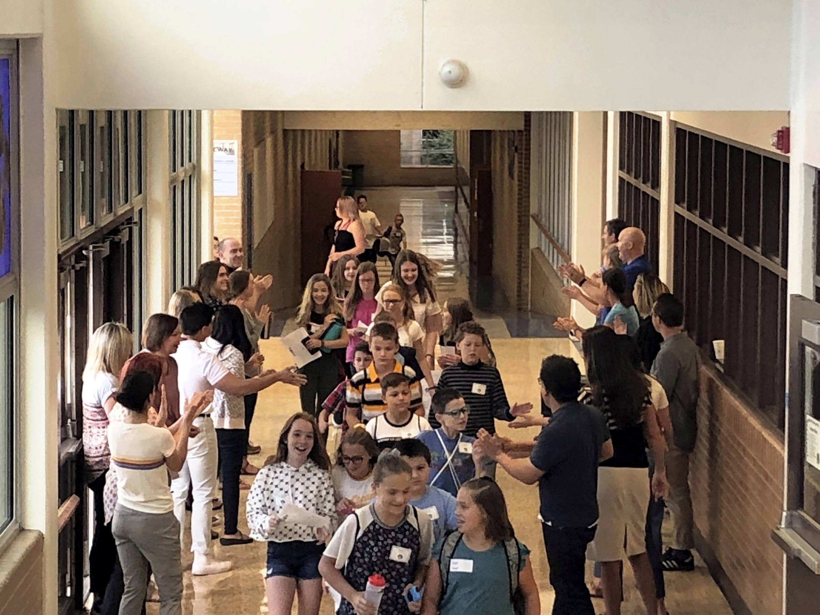
Over 870 Students
That’s 870 with whom you can make a friend

