Slide 1
Technology Usage

Slide 2
Use electronics ONLY when permission is given from your teacher.

Slide 3
Headphones (wired & wireless) and Earbuds (wired & wireless) are NOT allowed to be used during class time.

Slide 4
It is advised all expensive and valuable electronics be left at home to keep them safe.

Slide 5
If you use your electronics during class without permission…
Electronics will be confiscated by staff:
1st violation – the device will be brought to the attendance office and can be picked up at the end of the day by the student.
2nd and all other violations – the device will brought to the attendance office and picked up by a Parent/Guardian.

Slide 6
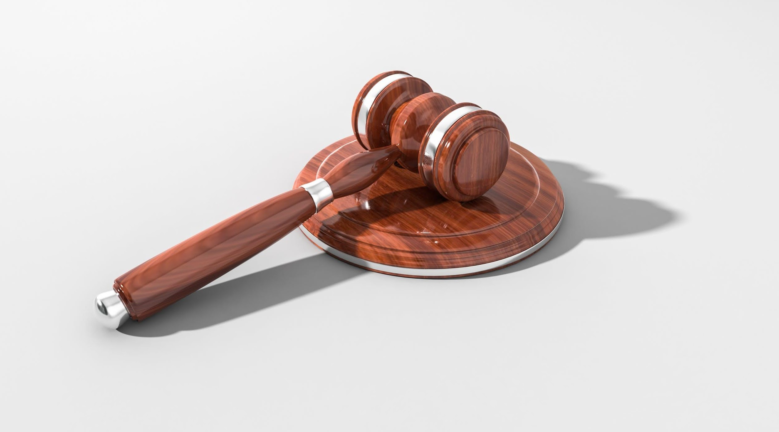
Privacy
Any use of an electronic device that exploits personal information, disrupts the educational process, is used for cheating, compromises personal privacy or the integrity of educational programs is strictly forbidden.
Students violating these guidelines will be subject to school discipline.

Slide 7
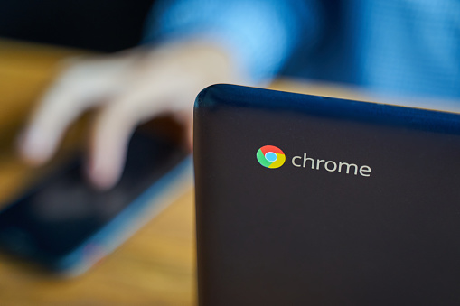
Chromebooks
This year, each of you will receive a Chromebook to use during your time as a student at Union Middle School.
You will be responsible for taking good care of your device while it’s in your care. If you damage it, you will be responsible for replacing the Chromebook. (Replacement cost can be up to $200 dollars.)

Slide 8
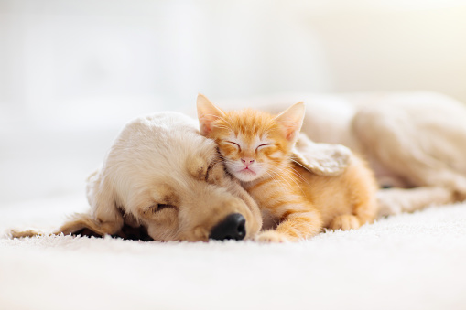
Chromebook Care
Wipe down after use (at home)
Recharge the device each night at home—very important!
Put carefully into your backpack.
Notify your teacher if your Chromebook has an issue—we have someone who can fix it, if needed.
If your Chromebook were your pet, would it be happy with the way you treat it each day?

Slide 9
∞
Infinite Reasons | Middle School is Great

Slide 10
Union 🖤 Halloween

