Slide 2
Caring and Respectful Attitude
Use a soft voice
and
Respect your neighbor

Slide 3
Arrive on Time
I do not bring food or drink into the library

Slide 4
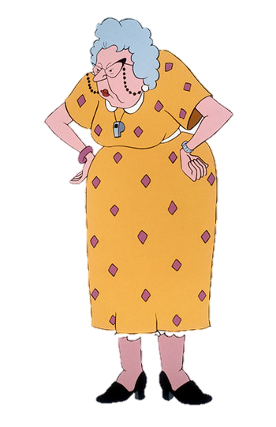
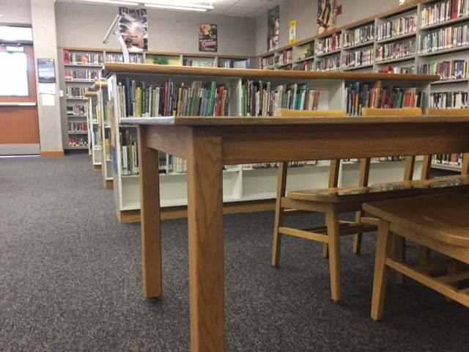
Take Responsibility
I push my chair in and clean up after myself
Will you please tuck in your chair?

Slide 5
When Can I Come to the Library?
For the near future, the library will be closed before school and during lunch until we determine how best to keep everyone safely distanced. You can make a digital request for Books through Destiny Discover. Ms. Zhang will be showing you this in your ELA classes.
Stay tuned for library hours :)

Slide 6
∞
Infinite Reasons | Middle School is Great

Slide 7
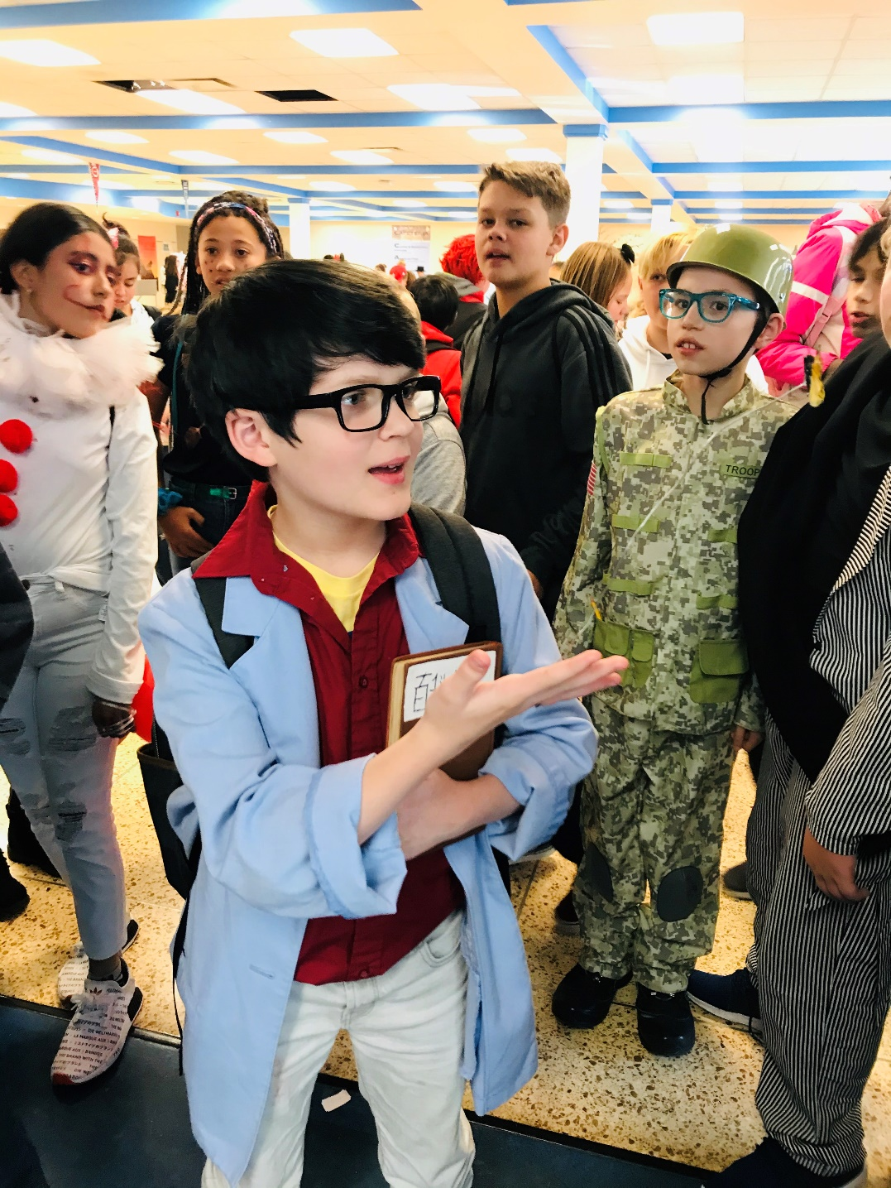
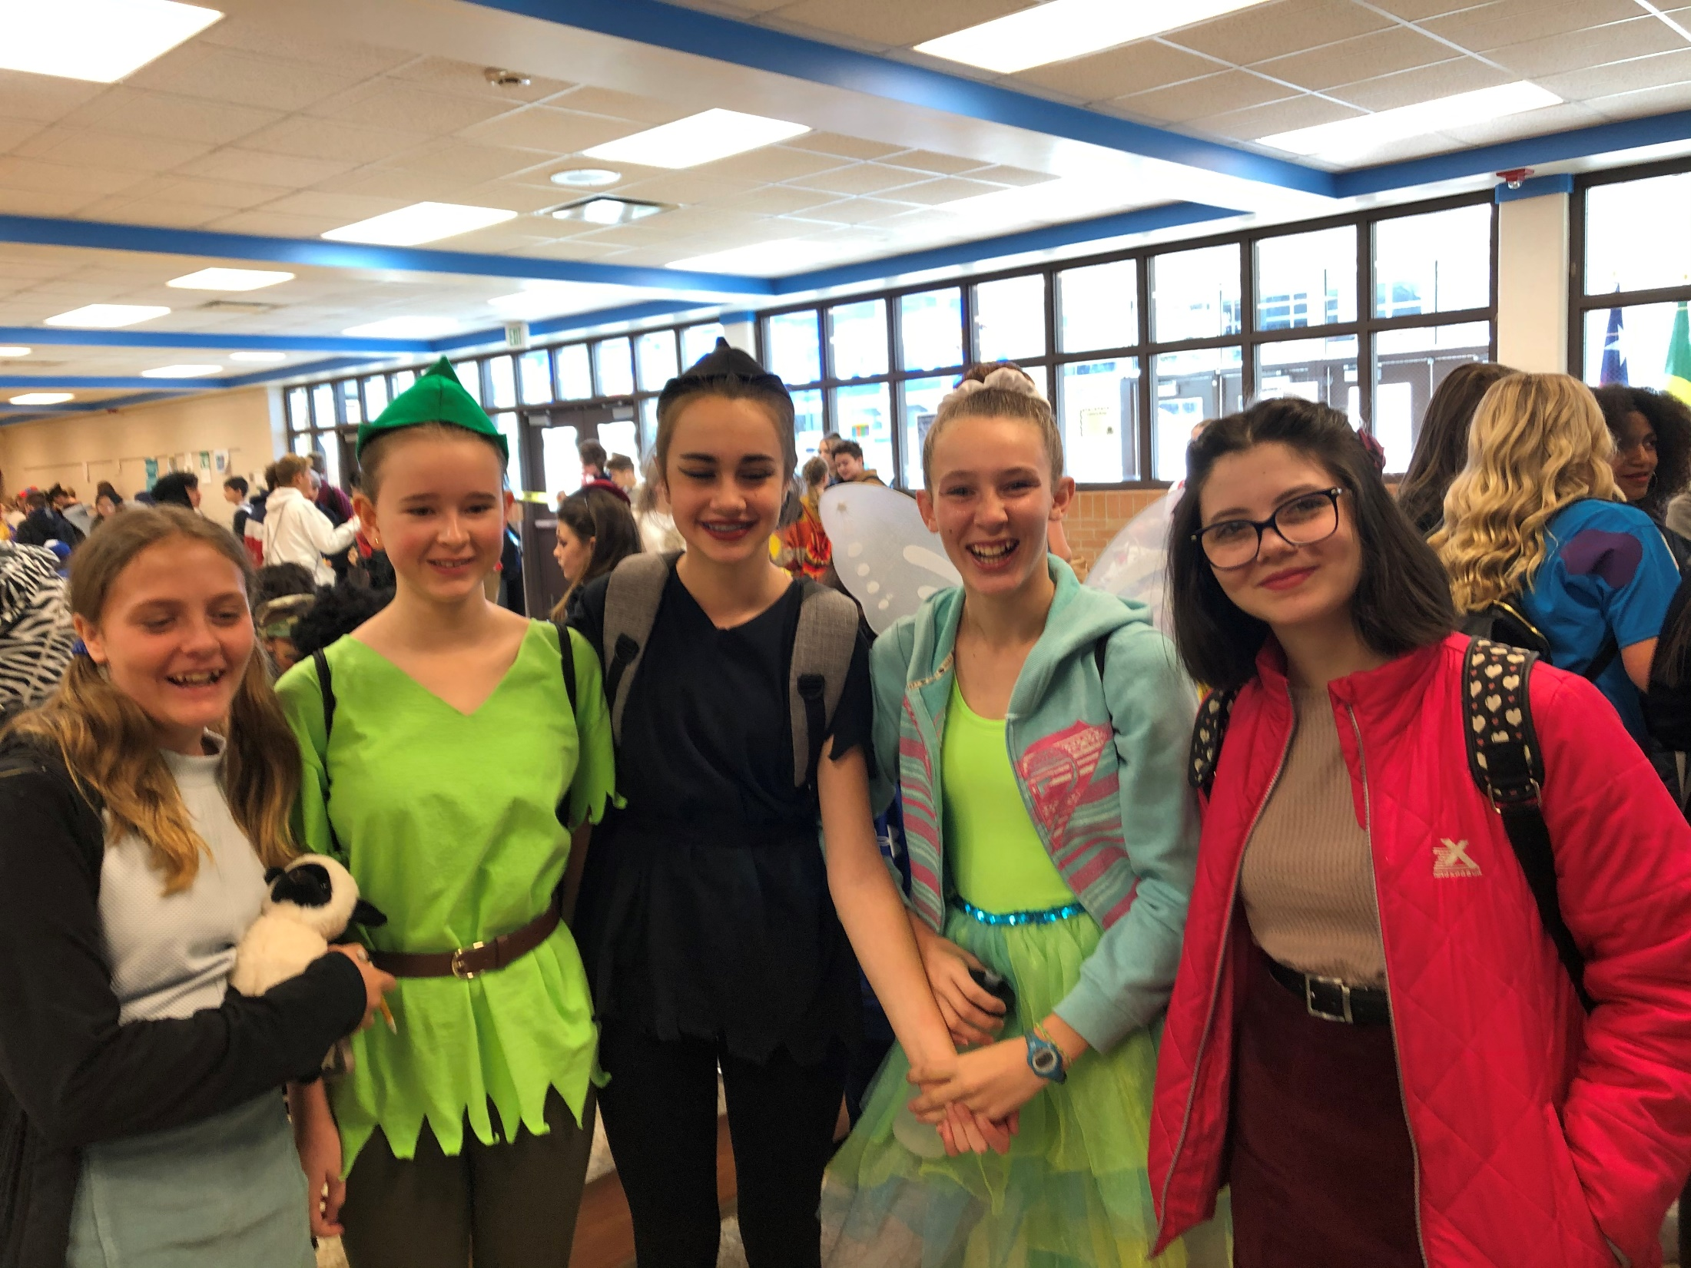
Spirit Week!

