Slide 1
Fighting

Slide 2
What is fighting?
Definition:
Fighting is engaging in or provoking mutual physical contact involving anger or hostility, including deliberately arranging a fight or willing participating in such a fight.

Slide 3
Let’s break this down:
The common image of two or more kids fighting is a fight
If you keep pestering someone so they fight you, it is a fight
If you arrange a fight
(online or in person)
and if the fight happens
or does not happen, it is a fight

Slide 4
Let’s break this down:
If you flock to a fight or encourage a fight to start or continue, you can be charged with fighting for “aiding and abetting” a fight.
If you contribute to a fight by carrying a rumor from group to group with the intent of creating a fight or know a fight will start because of the rumor, you can be charged with fighting.

Slide 5
What happens if I Fight?
At a minimum ALL of the following will happen:
Firm (i.e. dispiriting & stiff) conversation with administration
Phone call home
To your parent/guardian
To the victims parent/guardian
School Based Consequences:
Out of School Suspension
Fined 50 dollars
Required to take a 4-week class evening Anger Management Class

Slide 6
How can you avoid fights?
Be Nice
Use Uplifting Words

Slide 7
How can you avoid fights?
Get help. If you are angry with another student or group of students:
Talk with your teacher
Ask to see your counselor
Ask to see your administrator
Talk with your parent/guardians

Slide 8
How can you avoid fights?
THINK. Don’t feel you have to prove yourself because someone else “challenges” you.
Be in the RIGHT PLACE:
Never show up to a fight
Never be a place where a fight is to happen

Slide 9
WARNING
Do not choose to resolve any problem by fighting.
If you choose to fight you are choosing to be suspended from school, fined 50 dollars, take a 4-week evening class and have a conference with your parent/guardians and school personnel.
You are responsible for your behavior. No one makes you fight. You chose to fight. You can always chose to walk away and seek a better solution through mediation and help.

Slide 10
Is there such a thing as “self-defense?”
It is tricky and complicated, but yes.
“Self Defense” is defined as blocking or shielding yourself from an attack, moving away from an attack, or getting help
If you hit or kick back, then you are fighting

Slide 11
Is there such a thing as “self-defense?”
Also for it to be considered self-defense all of the following have to be met:
You cannot be the aggressor
The threat must be at that moment
You can only use enough force to block or shield yourself from an attack
You have a responsibility to retreat and get an adult

Slide 12
One More Time
How to avoid fights:
Be Nice
Use Uplifting Words
Get Help
Think
Be in the Right Place

Slide 13
∞
Infinite Reasons | Middle School is Great

Slide 14
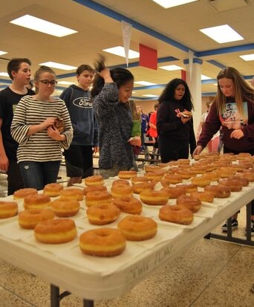
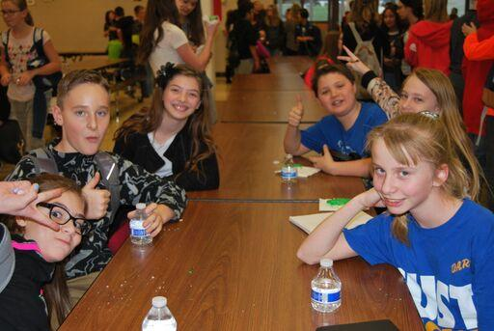
Honor Roll Parties

