Slide 1
2020-21
Welcome Back Union Bobcats!

Slide 2
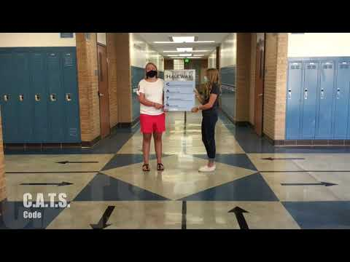
We can’t wait to get started with our new school year. Let’s start with a back-to-school video!

Slide 3
Now, let’s be sure you know where to go:
Reading Your Schedule

Slide 4
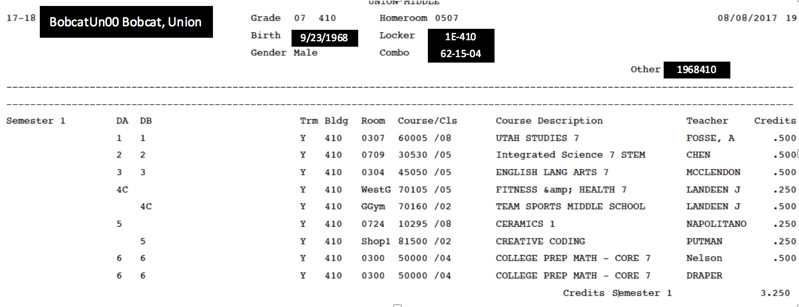
Reading Your Schedule
A-Day Schedule
B-Day Schedule

Slide 5
What lunch do I have?
The letter after
4th period
tells you which lunch you have.

Slide 6
What does 7th period Advisory on my schedule mean?
This year, each student has been assigned an advisory teacher.
This class is held ONLY on FRIDAY after 2nd period (for 30 minutes)
In this class we will be building connections and learning about social emotional skills.
7th Advisory only meets on Friday.

Slide 7
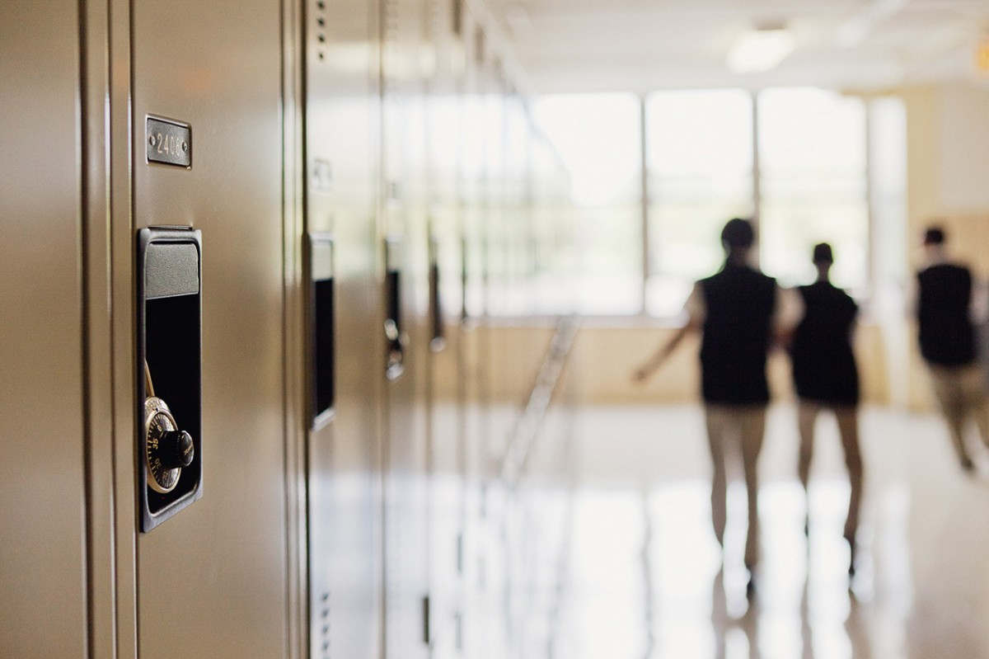
At this point, no lockers will be assigned for health and safety reasons.
Locker Number
The number before the dash (-) let’s you know the hallway where your locker is located.
Locker Combo

Slide 8
∞
Infinite Reasons | Middle School is Great

Slide 9
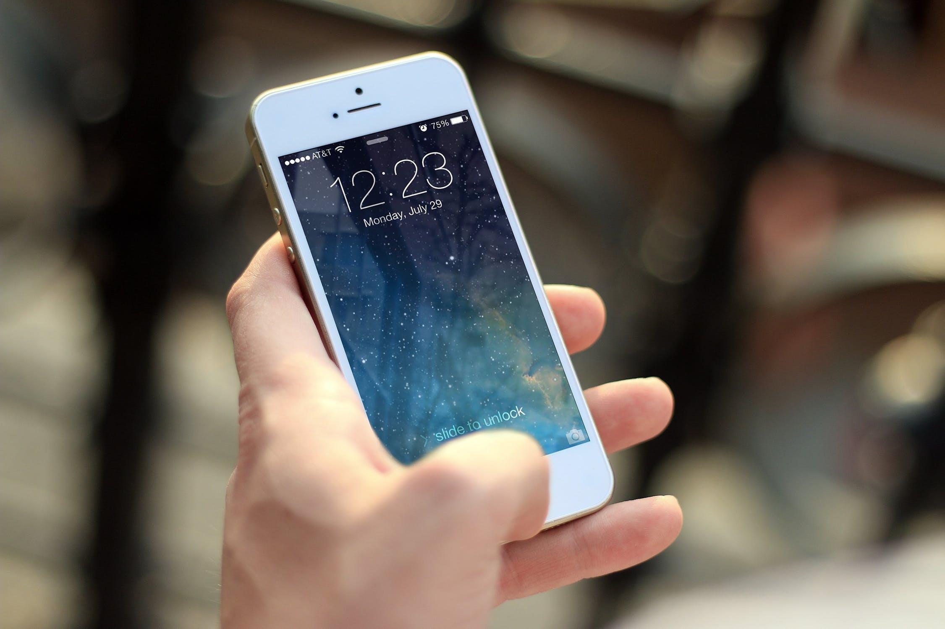
You Can Use Your Cell Phone in the Hallways (if done appropriately)

